Slide 1

British Airways
Customer Behaviour Prediction

Slide 2
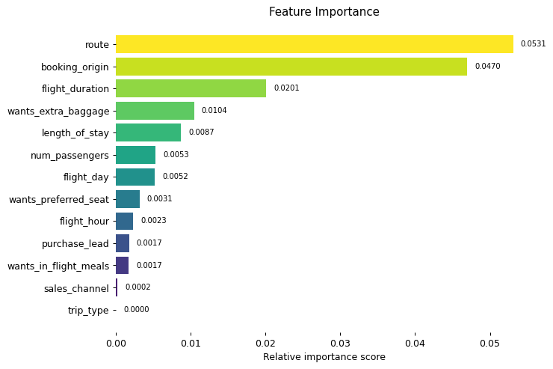
Evaluation
The most important feature was ‘route’ , that is the flight path from its origin to destination and back.
Information regarding flight time, duration of stay and baggage were seen to be significant, where as trip type and sales channels used were irrelevant.
Random forest with all the features considered performed the best with a precision (0.95) and recall (0.86).
The difference between the model with few best features and with all features were negligible, thus concluding further re-evaluation of the metrics.

